Slide 1
Zomato Restaurant Analysis

Slide 2
Introduction
Objective: Analyze Zomato restaurant data to uncover insights.
Key Focus Areas:
Restaurant distribution
Average price analysis
Customer ratings & reviews
Popular cuisines
City-wise trends

Slide 3
Data Cleaning & Preprocessing
Challenges:
Data contained null values, special characters in the field, currency was not distributed as per the countries.
Steps Taken:
Removed null values
Standardized currency & location data
Categorized price ranges
Removed Special Characters in the field

Slide 4
Overview
Dataset Overview:
Number of restaurants: 9551
Number of Countries : 15
Number of Cities : 141
Number of Cuisines : 1826
Average Rating of all the restaurant ; 2.89

Slide 5
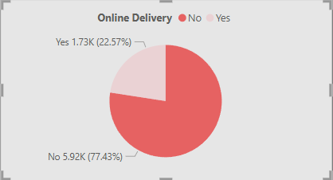
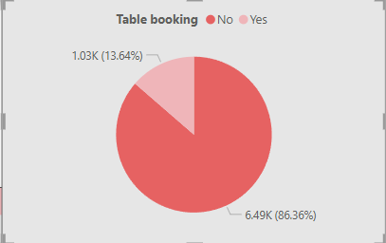
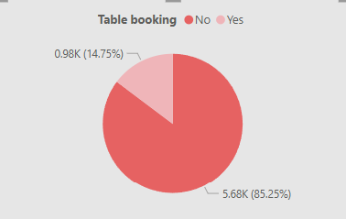
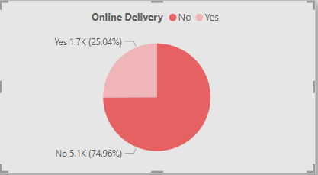
Observations
Out of 9551 restaurants
1.73K(22.57%) restaurants provides Online Delivery whereas 5.92k(77.43%) don’t have the online delivery system
Out of 9551 restaurants
1.03K(13.64%) restaurants provides table booking whereas 6.49k(86.36%) don’t have the table booking facility
For India
Out of 8652 restaurants
1.7K(25.04%) restaurants provides Online Delivery whereas 5.1k(74.96%) don’t have the online delivery system
Out of 8652 restaurants
0.98K(14.75%) restaurants provides table booking whereas 5.68k(85.25%) don’t have the table booking facility

Slide 6
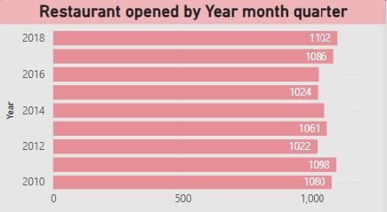
Countries which don’t provide online delivery and table booking facility are : Indonesia, Canada, New Zealand, Brazil, Singapore, Sri Lanka Turkey, United States.
In the year 2018 most restaurants were opened (i.e 1102)whereas least restaurants opened in the year 2012(1022)
New Delhi has the most restaurant 5473

Slide 7
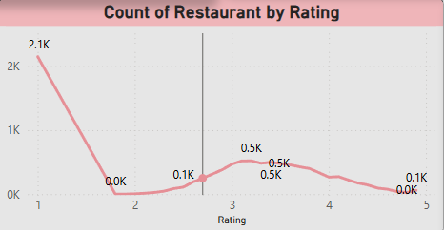
Highest count at Rating 1 (2.1K restaurants)
A significant number of restaurants received the lowest rating.
This could indicate dissatisfaction, poor service, or bad food quality for a large segment.
Sharp drop to nearly 0 at Rating 2
There is almost no representation at a rating of 2.
This suggests that restaurants either receive very low or moderate-to-good ratings, skipping the middle ground.
Gradual rise in Ratings 3 to 4 (around 0.5K each)
Ratings 3 and 4 have a similar number of restaurants (~500 each).
This indicates that a moderate number of restaurants are rated average to slightly above average.
Slight decline toward Rating 5
Only about 0.1K (100 restaurants) received a perfect 5-star rating.
This suggests that very few restaurants achieve the highest rating, possibly due to high customer expectations.

Slide 8
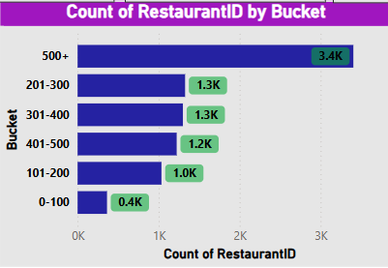
Average cost for two
Restaurants with Average cost for 2 between 0-100 bucket are 0.4k
Highest i.e 500+ average cost there are 3.4k restaurants.
Most restaurants fall into the 500+ category, suggesting market concentration at the higher end.
The middle categories (201-500) have a balanced distribution
This analysis suggests that a significant portion of restaurants have a high volume of Price, possibly due to chain restaurants or high operational scale

Slide 9
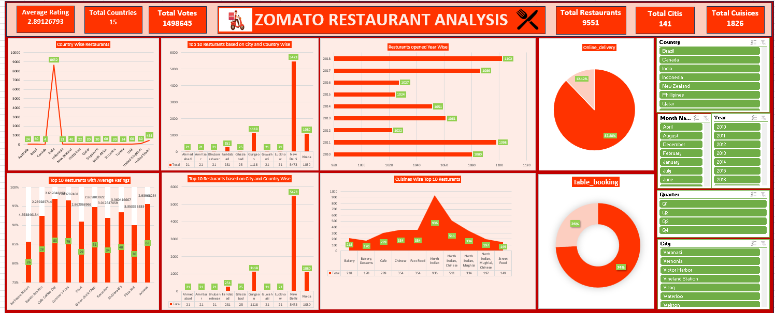
Excel Dashbaord

Slide 10
Summary
India dominates the restaurant count.
The majority of restaurants do not offer online delivery or table booking.
North Indian cuisine is the most popular.
Restaurant openings have been consistent, peaking in 2011 and 2018.
The average rating is relatively low (2.89), indicating room for improvement in customer satisfaction

Slide 11
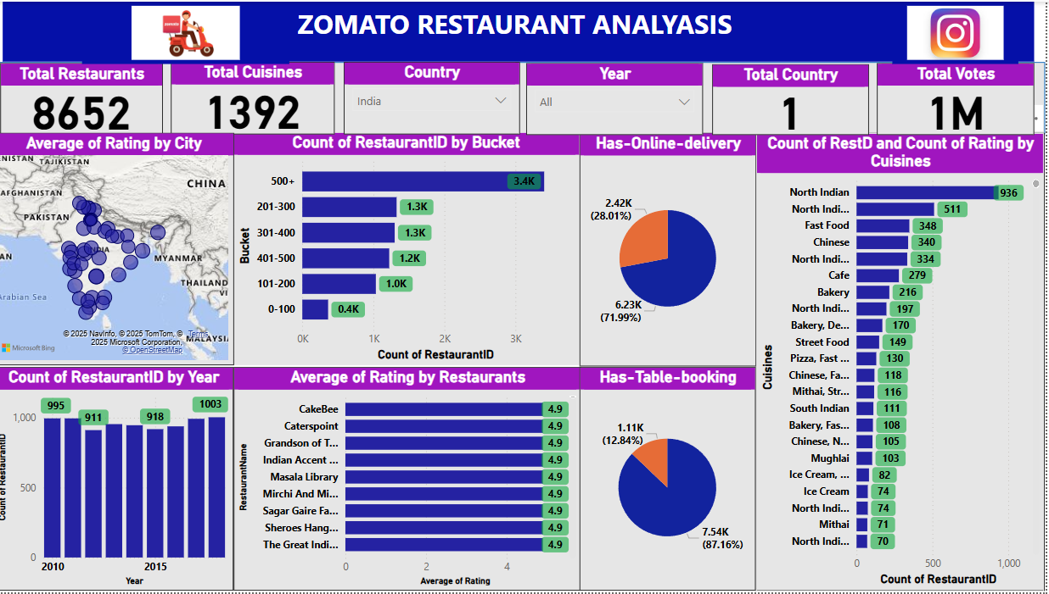
PowerBI Dashbaord

Slide 12
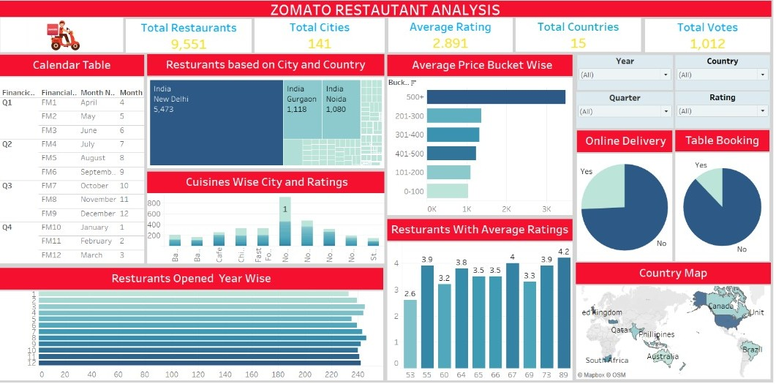
Tableau Dashboard

Slide 13
Competitor & Market Analysis for the Low rating Restaurants\
🔹 Competitor Benchmarking: Compare restaurant performance (ratings, reviews, orders) against competitors. 🔹 Customer Segmentation: Identify high-value customers and repeat buyers to improve loyalty programs. 🔹 Regional Expansion Opportunities: Identify cities/countries with high potential but low restaurant penetration.
Customer Behavior & Satisfaction
🔹 Customer Feedback Analysis: Identify common complaints or positive reviews to improve service. 🔹 Loyalty & Retention Metrics: Track repeat customers and analyze their average spending patterns. 🔹 Order Trends by Time of Day: Identify best-selling dishes and peak ordering times

Slide 14
Restaurant Performance & Profitability
🔹 Identify Underperforming Restaurants: Compare ratings, reviews, and sales data to detect struggling locations. 🔹 Cost & Profit Analysis: Track expenses, food costs, and delivery charges to optimize pricing strategies. 🔹 Most Profitable Cuisines & Dishes: Identify high-margin cuisines and promote them accordingly.
Business Growth Strategy
🔹 Franchise & Expansion Strategy: Identify high-potential cities/countries for launching new branches. 🔹 Strategic Marketing Plan: Use historical trends to optimize advertising budgets and promotions. 🔹 Delivery & Logistics Optimization: Improve delivery efficiency by analyzing delivery times and costs.

Slide 15
Thank You

